Slide 1
TOSCA, McStas Mantid

Slide 2
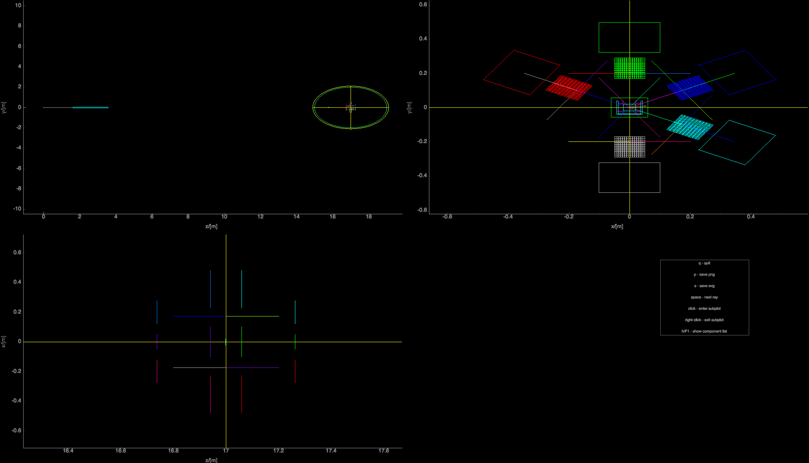
TOSCA in McStas - views along axes

Slide 3
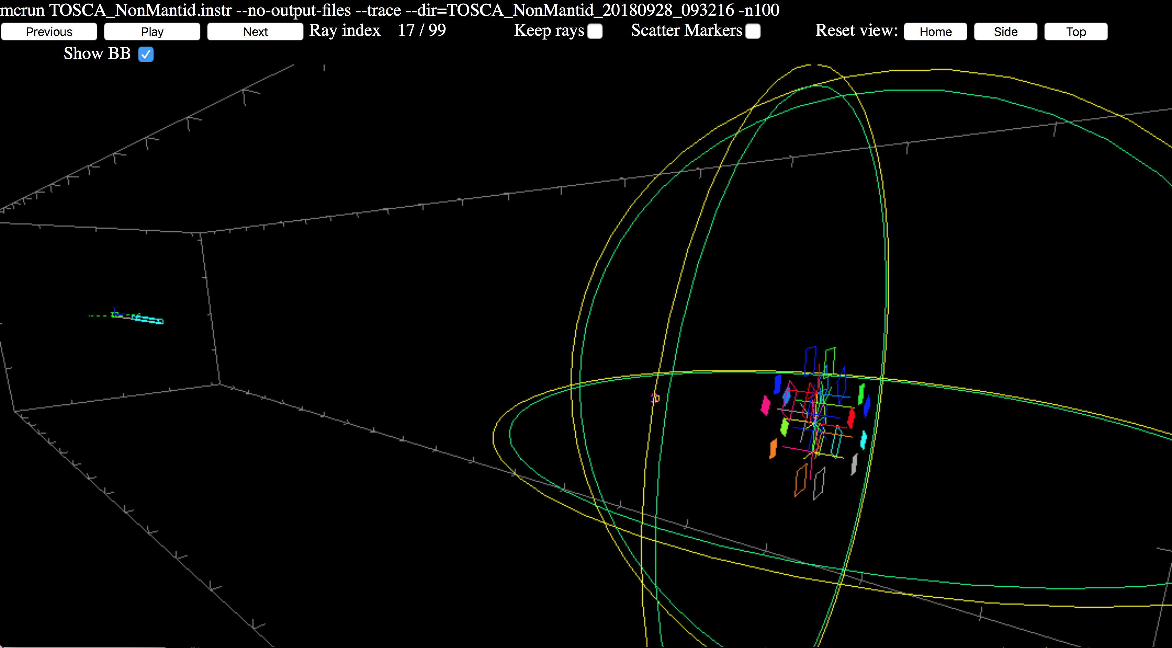
TOSCA in McStas - WEBGL view

Slide 4
TOSCA in McStas - WEBGL view
Available in DropBox MDANSE2018/Practical_I+N,_Molecular_spectroscopy/TOSCA_NonMantid_WEBGL/index.html

Slide 5
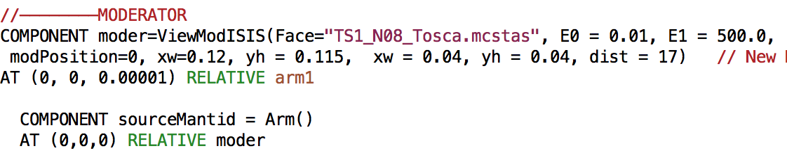
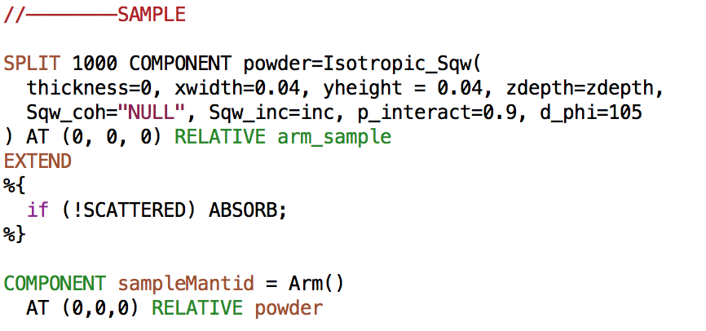
TOSCA transported in Mantid
(General recipe available in https://github.com/McStasMcXtrace/McCode/wiki/McStas-and-Mantid )
1. Mantid needs to know where the source is located
2. … and where the sample is located

Slide 6
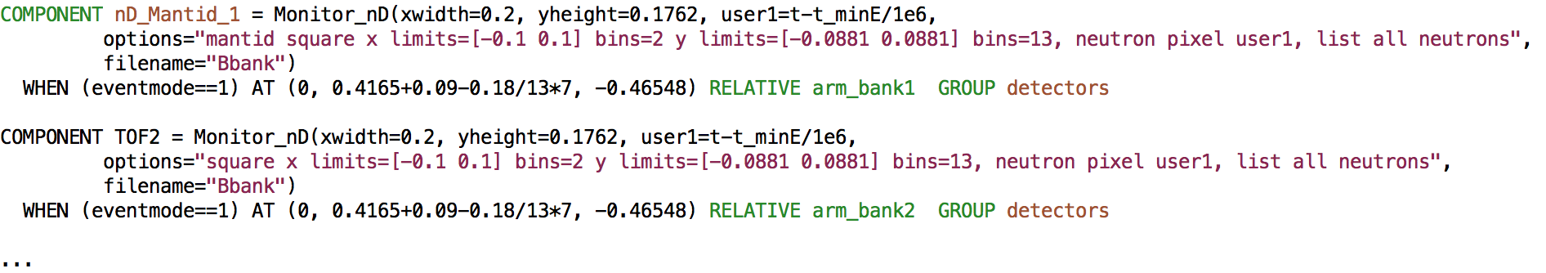
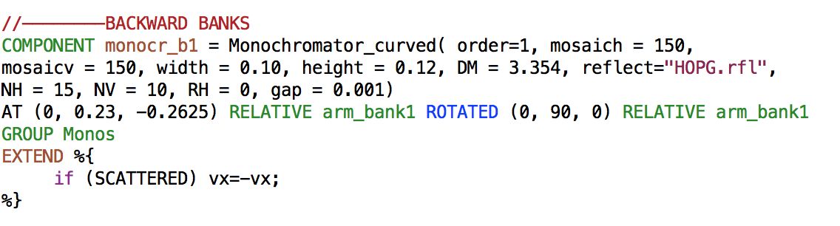
TOSCA transported in Mantid
3. Addition of a special series of event monitors - here first backward banks
4. Geometrical trick - since Mantid directly uses distance between sample and detector for kf calculation - the analysers are tricked to transmit the reflected beam
5. And detectors then placed behind the analysers instead of toward sample…
6. Recorded ToF is made relative to beam onset at sample

Slide 7
TOSCA transported in Mantid
3. Addition of a special series of event monitors - here first backward banks
4. Geometrical trick - since Mantid directly uses distance between sample and detector for kf calculation - the analysers are tricked to transmit the reflected beam
5. And detectors then placed behind the analysers instead of toward sample…
6. Recorded ToF is made relative to beam onset at sample

Slide 8
TOSCA transported in Mantid
6. Instrument must be compiled with NeXus capability
export MCSTAS_CFLAGS=“-g -lm -O2 -DUSE_NEXUS -lNeXus”
(MCSTAS_CFLAGS_OVERRIDE if using python tools)
7. IDF in xml format must be generated using mcdisplay.pl
mcdisplay TOSCA_Mantid_2.instr —format=Mantid -n0
-> TOSCA_Mantid_2.instr.xml
8. Simulation should generate NeXus output, i.e.
… demanding, required 4 hours using MPI on Quad-Core Intel i7 last night…
mcrun TOSCA_Mantid_2.instr inc=bz_inc_castep2.sqw eventmode=1 -n1e7 --format=NeXus
Energy range 0.01 - 500 meV

Slide 9
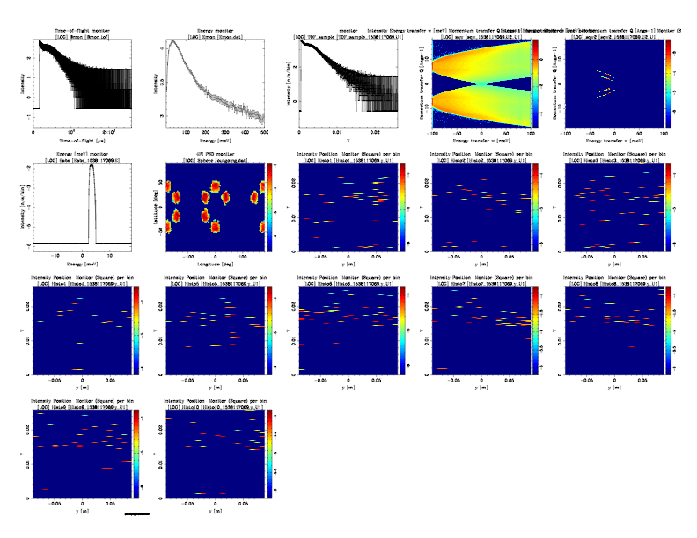
McStas output outside Mantid
--ncount 1e6

Slide 10
McStas output outside Mantid
Spectrum and ToF at sample position…

Slide 11
McStas output outside Mantid
S(q,⍵) as scattered by sample and what remains after
the analysers

Slide 12
McStas output outside Mantid
Absolute neutron energy and spatial location of beams on 4PI monitor…

Slide 13
McStas output outside Mantid
… result is relatively sparse in ToF on the individual
panels…

Slide 14
The event data are then reduced in Mantid
Steps:
ConvertUnits on event dataset, indirect geometry and Efixed of 1.85
Rebin dataset to achieve spectra
SumSpectra to get the final reduced dataset

